Slide 1
DELETE THIS THIS BEFORE PRESENTING
This is a slide deck template. It has slides you may wish to use during a water affordability presentation, but you can make changes.
The slides can be used as-is, or you can add slides, copy slides into another presentation, and so on. Additionally, you may wish to delete slides, depending on the length of your presentation and/or relevance to your audience.
Each slide includes speaker notes to assist you. (See below)
Contact Elevate with questions: ElevateNP.org/Contact-Us
Notes:
This is an example of speaker notes.
Don’t forget to delete this slide before presenting!

Slide 2
Water Affordability
Topic overview & What you can do

Slide 3
Agenda
Learn about water debt and how it may occur
Understand how it affects your neighborhood and neighborhoods across Chicago
Learn to read and understand your water bill
Learn what you can do if you are experiencing a water burden

Slide 4
Affordability and Debt
Water Affordability
  Definition: A function of the interaction between two factors
    Cost of service
    Income
Water Debt occurs when the water bill payor can not afford to pay the bill balance on time
  Definition: The previous balance listed on the current bill minus the payments listed on the current bill, also referred to as “arrears”
Notes:
“Water affordability” is impacted by two factors: cost of service and household income. Because income is such an important factor in affordable, the same water bill (i.e., the same water rate and same volume of water used) can be very affordable to one household but very unaffordable to another. When water is unaffordable, water debt can build up as households struggle to pay and remain current on their water bill.

Slide 5
Chicago Water Bill Increase (2009-2019)
Garbage Fee Added
Tax
Added
SOURCE: MPC, Elevate, IISG (2020). Water Affordability in Northeastern Illinois. bit.ly/3PKvPN3
Notes:
Water affordability challenges are becoming increasingly widespread in northeastern Illinois. The yellow line shows changes in median income for households in Cook County, Illinois, between 2009 and 2019. The green line shows Chicago water rates over the same period and increasing at a much faster rate.

Slide 6
Critical Water Affordability Challenges in Chicago
Notes:
Elevate and Metropolitan Planning Council conducted an analysis of water billing data and demographic data in partnership with the City of Chicago. The analysis shows that water affordability is a growing concern. Several key takeaways are shown in the following slides.

Slide 7
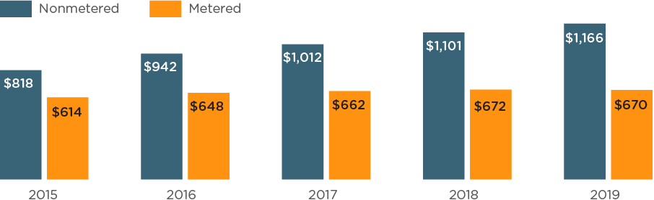
Non-metered Customers Pay More
In 2019, Chicago’s non-metered customers paid $500 more than metered customers.
SOURCE: Elevate (2022). Chicago Water Affordability Analysis. bit.ly/43H3Ljk
Notes:
City of Chicago Water Affordability Analysis / Key Finding 1: Non-metered customers face more affordability challenges than metered customers. In 2019, non-metered customers paid $500 more than metered customers.

Slide 8
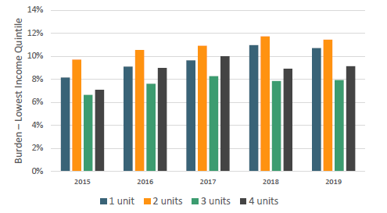
Two-Unit Buildings Highest Burdened
Two-unit buildings have the highest average burden among
building types
SOURCE: Elevate (2022). Chicago Water Affordability Analysis. bit.ly/43H3Ljk
Notes:
City of Chicago Water Affordability Analysis / Key Finding 2: Multi-family buildings see the highest rates of non-payment and debt increases over time, and two-unit buildings have the highest average “water burden,” averaging 10% for years 2015-2019. (NOTE: “water burden” refers to the percentage of a household’s income that goes toward paying water bills)

Slide 9
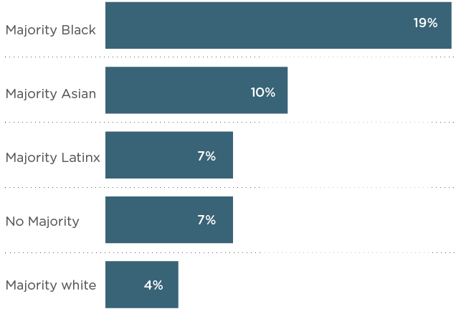
Racial Inequity
Chicago census tracts with majority Black, Latinx, and Asian populations have an average higher water burden
Graph shows average % of annual income paid on water bills for lowest income community members
SOURCE: Elevate (2022). Chicago Water Affordability Analysis. bit.ly/43H3Ljk
Notes:
City of Chicago Water Affordability Analysis / Key Finding 3: Accounts in majority Black, Latinx, and Asian populated census tracts are less likely to be metered, more likely to have leaks, and face on average a higher water burden than accounts in majority white (non-Hispanic) tracts.

Slide 10
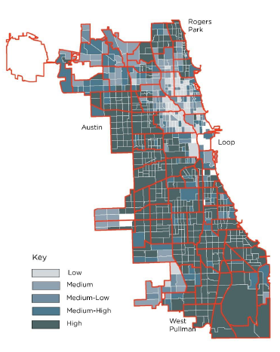
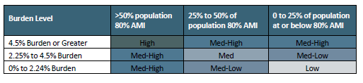
Water Bill Burden
Water Bill Burden
A ratio based on the percentage of a household’s income that goes toward paying water bills. EPA threshold is 4.5%.
Map shows burden per unit for the lowest income earners in a census tract in non-metered residential buildings.
SOURCE: Elevate (2022). Chicago Water Affordability Analysis. bit.ly/43H3Ljk
Notes:
City of Chicago Water Affordability Analysis / Key Finding 4: Water debt carries significant weight. For 20% of customers with an outstanding water bill balance, that balance was larger than a full year’s worth of bills.

Slide 11
Understanding Your Bill
Notes:
To help you understand your water bill, the following slides include examples of bills for metered and non-metered accounts.

Slide 12
Chicago Water Bills: The Basics
The City of Chicago is responsible for the supply and delivery of water to all households within City limits. There are two types of water bill accounts: metered and non-metered.
Type of Account | Description | Billed | Rate
Metered | Properties with a meter installed that can measure water usage | Monthly or bi-monthly | Customer pays based on actual usage (measured in cubic feet or gallons),
Non-metered | Properties that do not have a meter installed and, instead, calculate assumed water usage | Monthly | Customer pays a flat rate based on building size, lot size, and number of plumbing fixtures
Notes:
Metered accounts, as the name implies, are properties with a water meter. A water meter measures the volume of water passing through it, and the City of Chicago charges customers based on that volume of water. For example, if a household uses 8,000 gallons, and the water rate is $4.55 per 1,000 gallons, the City will charge $36.40. Non-metered accounts do not have a water meter to measure usage. Instead, these accounts are charged a flat rate (i.e., same every month) based on factors such as the building size, square footage of the lot, and the number of plumbing fixtures.

Slide 13
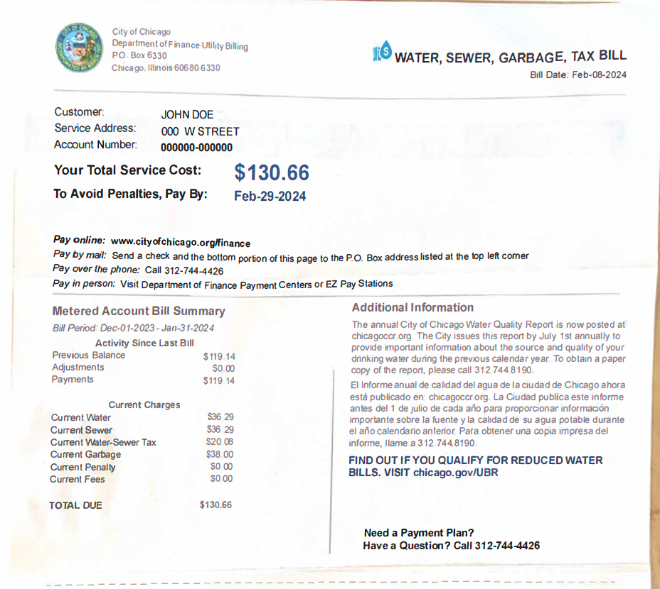
What is on my water bill?
METERED ACCOUNT
This is a sample metered water bill from the City of Chicago. There are several key components to consider:
The top line contains the address and account number
Billing period information and an itemized list of applicable charges
The bill begins with the previous amount paid by the consumer ($119.14), followed by adjustments and payments made
The new charges for the given billing period begin with “Current Water” and include three unique payments: water, sewer, and garbage
Notes:
This is an example of a bill for a metered account.

Slide 14
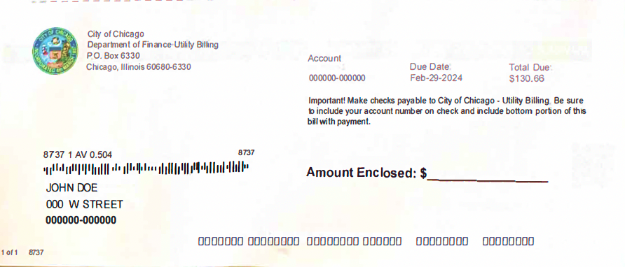
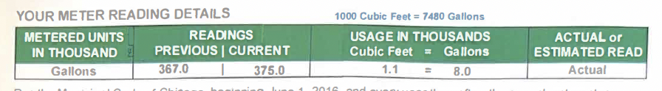
What is on my water bill?
METERED ACCOUNT
If planning to pay by check, you can rip this final portion off
Mail the check along with the bottom portion of the page
The actual meter reading is contained on the second page of your bill
Notes:
This slide highlights some key elements on a water bill for a metered account.

Slide 15
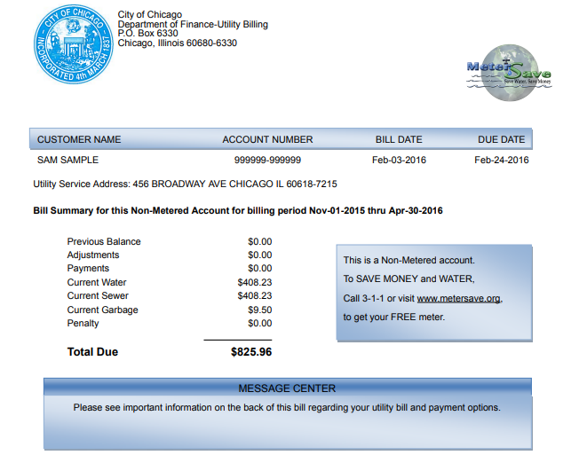
What is on my water bill?
NON-METERED ACCOUNT
This is a sample non-metered water bill from the City of Chicago. There are several key components to consider:
The top line contains the account number and bill dates
An itemized list of applicable charges follows the address and billing period information
The bill begins with the previous balance, followed by adjustments and payments made
The new charges for the given billing period begin with “Current Water” and include three unique payments: water, sewer, and garbage
Notes:
This is an example of a bill for a non-metered account.

Slide 16
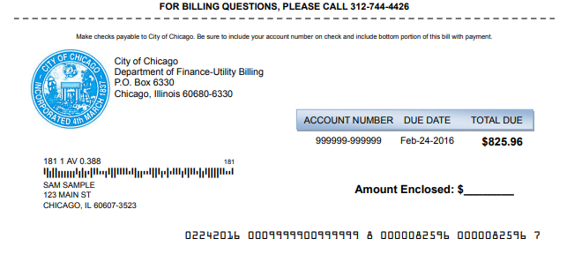
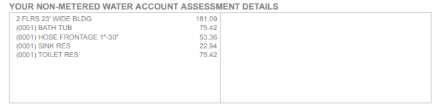
What is on my water bill?
NON-METERED ACCOUNT
If planning to pay by check, you can rip this final portion off
Mail the check along with the bottom portion of the page
The second page of the bill explains the “assessment details” of the property
Overall amount due is based on various measurements and the number of plumbing fixtures
Notes:
This slide highlights some key elements on a water bill for a non-metered account.

Slide 17
Water Bill Charges Defined
Water: The amount of water you are billed for is based on a meter reading or, for non-metered accounts, characteristics of the building
Sewer: Corresponds to 100% of your water charge
Garbage: Flat rate fee assessed monthly ($9.50/mo per dwelling unit)
Water-Sewer Tax: Charged at a rate of $2.51 per 1,000 gallons of water/sewer usage
Notes:
This slide provides an overview of the line items on a water bill.

Slide 18
Where does the money go?
Many people wonder where the money from their bill actually ends up. The answer depends upon which part of the bill is being considered.
The water and sewer charges go to the City of Chicago Department of Water Management to help fund projects that keep the infrastructure updated and functioning
The garbage fee helps keep city streets clean, and pays for all facets of collection and disposal
The water-sewer tax is utilized to help make mandated pension payments
In short, the money we pay goes toward ensuring that these vital systems continue to work
Notes:
When customers pay their water bill, the money goes towards keeping the system operating efficiently.

Slide 19
Where can I find assistance?
Notes:
For customers who cannot afford to pay their water bill, the City of Chicago offers some assistance programs.

Slide 20
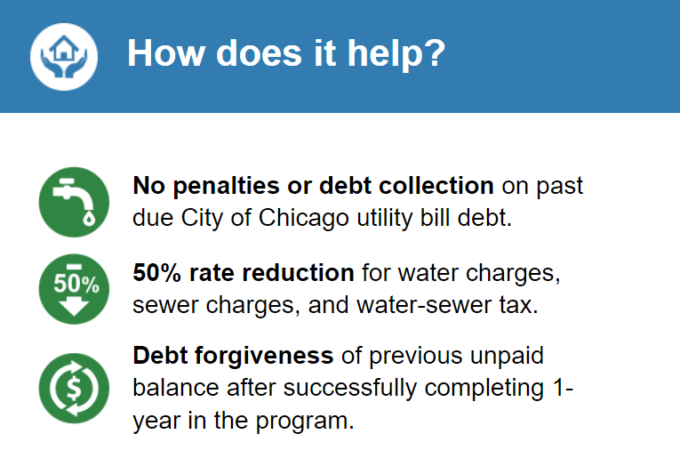
Utility Billing Relief
The Utility Billing Relief Program (UBR) is a City of Chicago program intended to make water and sewer bills more affordable for qualifying Chicago residents.
How to Apply:
Apply for UBR by contacting CEDA: (312) 782-CEDA
Apply with UBR online application: utilitybill.chicago.gov
SOURCE: chicago.docugateway.com
Notes:
The Utility Billing Relief Program began in 2020 to help eligible low-income customers. Once enrolled in the program, the City will not charge additional penalties for unpaid balances and rates are discounted 50%. After successful completion of the program (i.e., 12 consecutive discounted payments), all outstanding water debt will be forgiven and removed from the customer’s balance. If the customer fails to make 12 consecutive discounted payments, they may re-enroll in the program for a second year. The slide provides information on how to apply.

Slide 21
Utility Billing Relief
Household Size | 30 Day Gross Income
1 | $2,430
2 | $3,287
3 | $4,143
4 | $5,000
5 | $5,857
6 | $6,713
7 | $7,570
8 | $7,775
Eligibility requirements:
Property must be a single family or 2-unit
Applicant must be an owner of the property
Applicant must reside in the property
Applicant must meet the income eligibility requirements
Application process:
Provide proof of identity and proof of income for all household members
Processing time for applications is up to 30 days
If approved, will receive a welcome letter and enrollment confirmation
SOURCE: chicago.docugateway.com
Notes:
This slide shows the eligibility requirements for the UBR program.

Slide 22
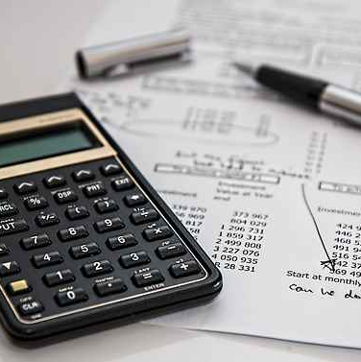
Payment Plans
For residents who are past due on utility bills but do not qualify for UBR, Chicago offers Utility Bill Payment Plans.
Payments can be made over a period of up to 36 months (or longer)
To remain on payment plan, installment payments and future utility bill charges must be made on time
Contact Utility Billing & Customer Service:
Online via online account management tool: utilitybill.chicago.gov
By phone using automated phone system: (312) 744-4426
By phone with a customer service rep: (312) 744-4426
In person at a Department of Finance Payment Processing Center
SOURCE: Grant Source via Flickr
Notes:
For households that are not eligible for the UBR program, the City offer payment plans. This slide provides information on the City’s payment plan program.

Slide 23
How can I save on water costs at home?
Notes:
In addition to the assistance programs explained previously, households can on save water costs using several water conservation and efficiency strategies.

Slide 24

Water Conservation & Efficiency
Pay attention to your water bill
Tackle that toilet
Stop the drips
Invest in water efficient devices
Invest in little habits that cut back on water use
Watch your water use outdoors
Water savings = Electricity savings
Get an energy assessment
SOURCE: cottonbro studio via Pexels
Notes:
“Water conservation” refers to using less water overall, such as turning off the tap while brushing your teeth. “Water efficiency” refers to using water more effectively, such as installing a toilet that flushes using less water. The slide provides some tips on improving water conservation and water efficiency, and more information is provided on page 2 of this handout: Water Affordability: Need to Know for Your Home - Elevate (elevatenp.org)

Slide 25

Discussion

Slide 26
Acknowledgements
These slides were developed by Elevate with additional support provided by Citizens Utility Board.
For more information, visit: ElevateNP.org/Water-Affordability
Contact Elevate at (773) 269-4037

